Slide 1
Cory Hofstad Presents:
An Academic Journal Review of
The Death of Rocket Science in the 21st Century
Published in Physics Procedia 20 (2011) 319-330
“Space, Propulsion & Energy Sciences International Forum – 2011”
Journal by G.A. Robertson and D.W. Webb
Institute for advanced Studies in the Space, Propulsion & Energy Sciences
265 Ita Ann, Madison, Alabama 35757
Journal Available online at www.sciencedirect.com
Cory Andrew Hofstad | cory.Hofstad@seattlecolleges.edu
https://www.researchgate.net/profile/Cory_Andrew_Hofstad

Slide 2
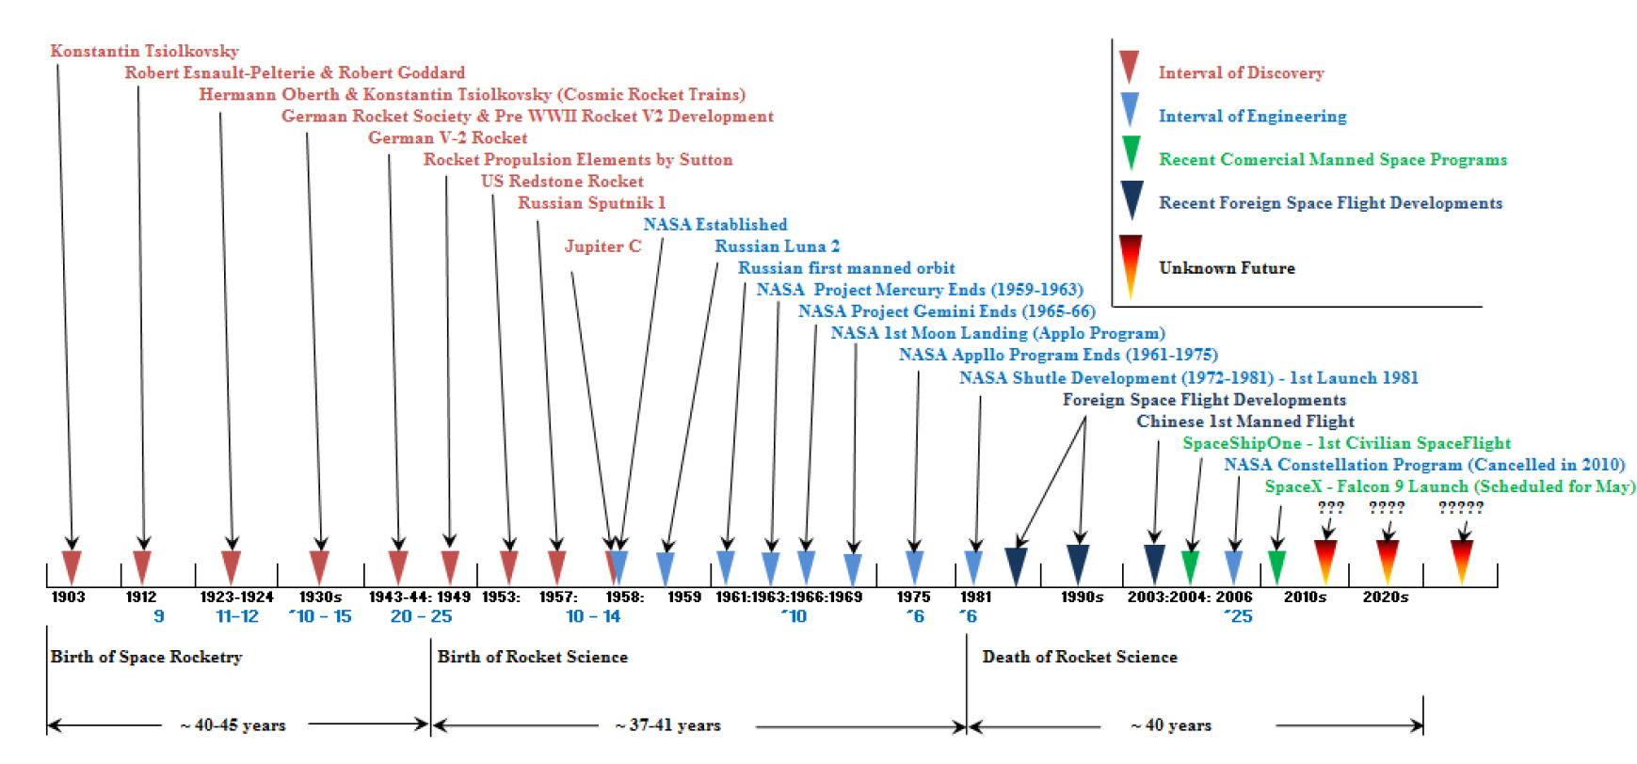
Research Question:
Are Rocket Scientists able to achieve a major breakthrough in timeline with the Kondratieff Interval?
Journal Context:
State of Rocket Science has been in decline since the early 80’s.
New developments in Aerospace rely on brute force
Chemical Fuel Dependency
Method: Tracking Scientific Breakthroughs via the Kondratieff Interval
Kondratieff Interval follows a 55 year interval
July 21, 2011—Final space shuttle mission ends when Atlantis arrives at Kennedy Space Center.

Slide 3
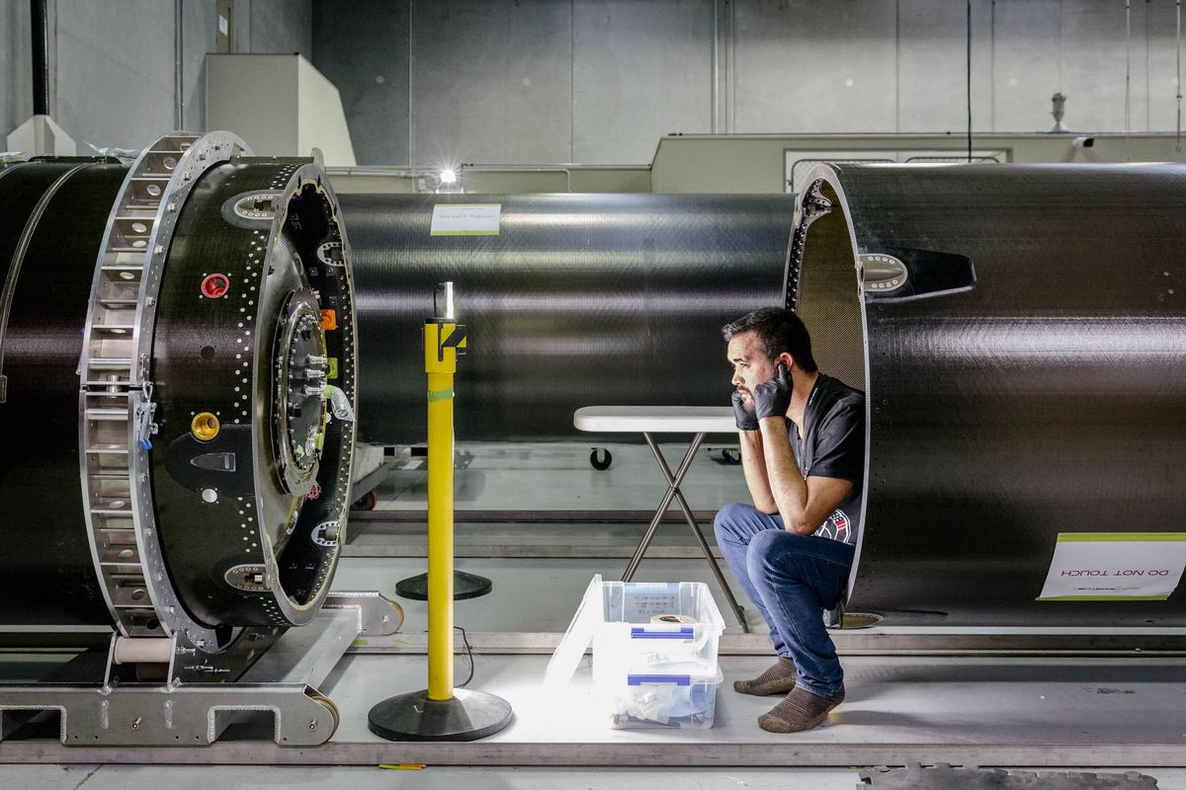
Reasons for a Decline in Scientific Propulsion Research:
Cost of research in a field of ever changing engineering requirements is too risky to pursue
Many governing organizations focus on near term mission goals instead of distant propulsion ideas and theory.
Training of many Aerospace Engineers is not in advancement of science, but in the development of hardware.
Effects on the academic researcher
The way we conduct aerospace engineering not only effects the future of governmental and commercial spaceflight missions, but has a negative effect in the way educational institutions are handling the next generation of engineers.
It is harder to get resources for a propulsion research project.
Research in Propulsion is looked at as not-feasible or not-doable within the resources allowed by some institutions, while other projects are allowed with less pushback.

Slide 4
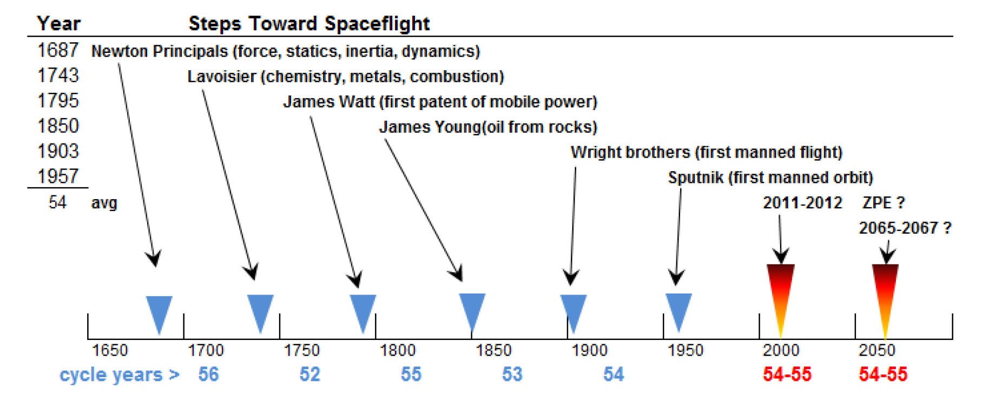
RESULTS:
We have not achieved a major breakthrough in Rocket Science, according to the Kondratieff Interval.
Integration of Space Propulsion Science and Aerospace Engineering:
Requires ”New Mindset in Leadership and Management”
Needs to Expand the Role of Propulsion Sciences within Aerospace Engineering.
Should integrate Relativistic Field Theory, Quantum Field Theory, High Energy Physics

Slide 5
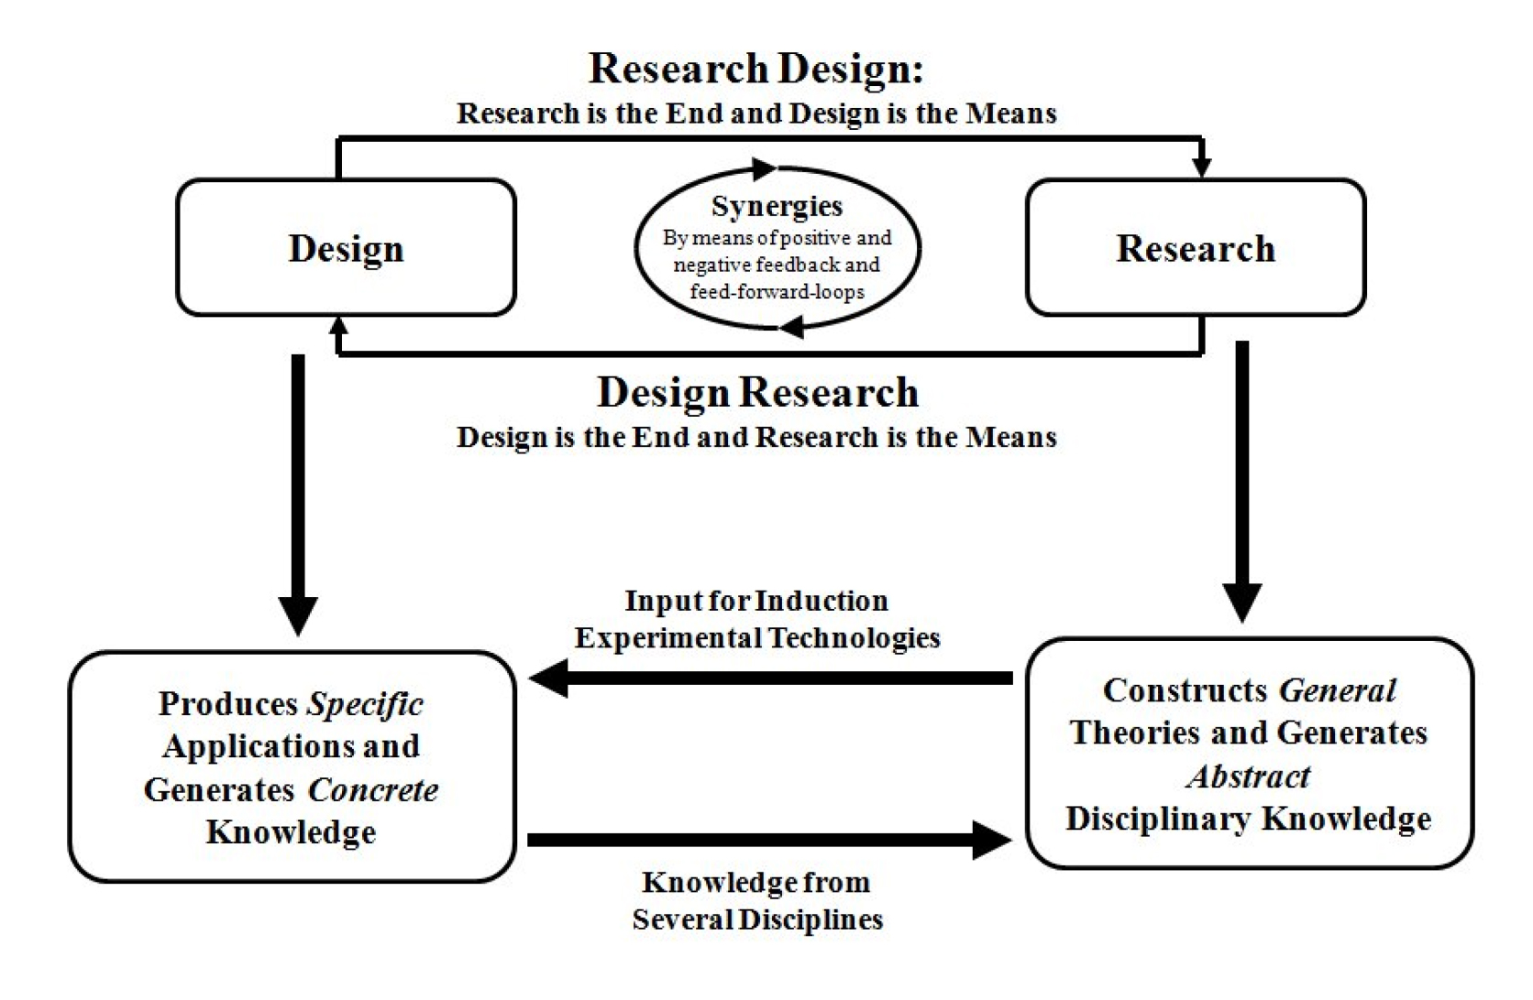
A New Method of Design and Development:
Scientific method of research and discovery must be integrated during the early design stages.
Interdisciplinary knowledge of physics, mathematics, chemistry and engineering must be married
Funding sources must accept the costs of doing research.

Slide 6
Conclusion:
Issues can be solved via use of the scientific method during the design phases of all current and future spaceflight missions.
Developing new theories, experiments, methods and curriculum must be a top priority for all future space flight missions.
Universities and Aerospace Engineering communities alike must develop programs that emphasize research and experimentation in new methods for attaining space flight.
Current Budgets must be re-allocated to ensure that finances are not being pumped into redesigning last years rocket, but instead finances should be dedicated to making breakthroughs in the way we utilize chemical fuel and electricity to achieve spaceflight.
REFERENCES:
G.A. Robertson and D.W. Webb / Physics Procedia 20 (2011) 319-330
Webb, Darryl W., The Historical and Future Economics of Propulsion and Energy Technology: Trends from 1750 and
Projections to 2100, Presented at the Space, Propulsion & Energy Sciences International Forum (SPESIF-10), Johns Hopkins
University, February 24-26, 2010.

